Slide 1
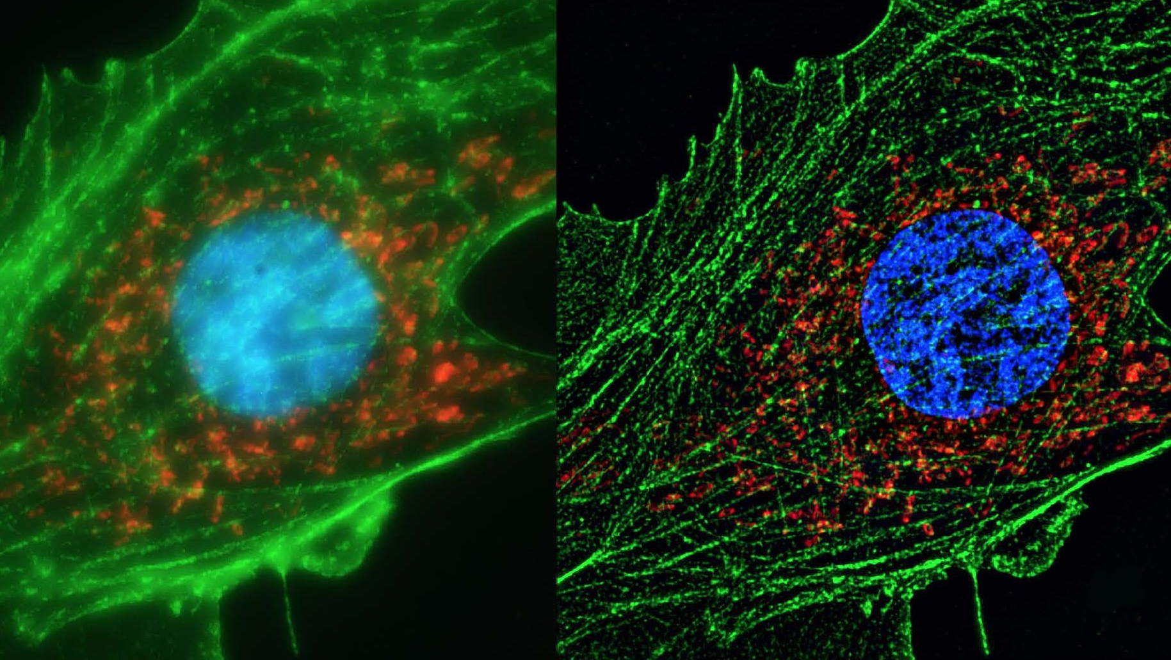
Super resolution techniques

Slide 2
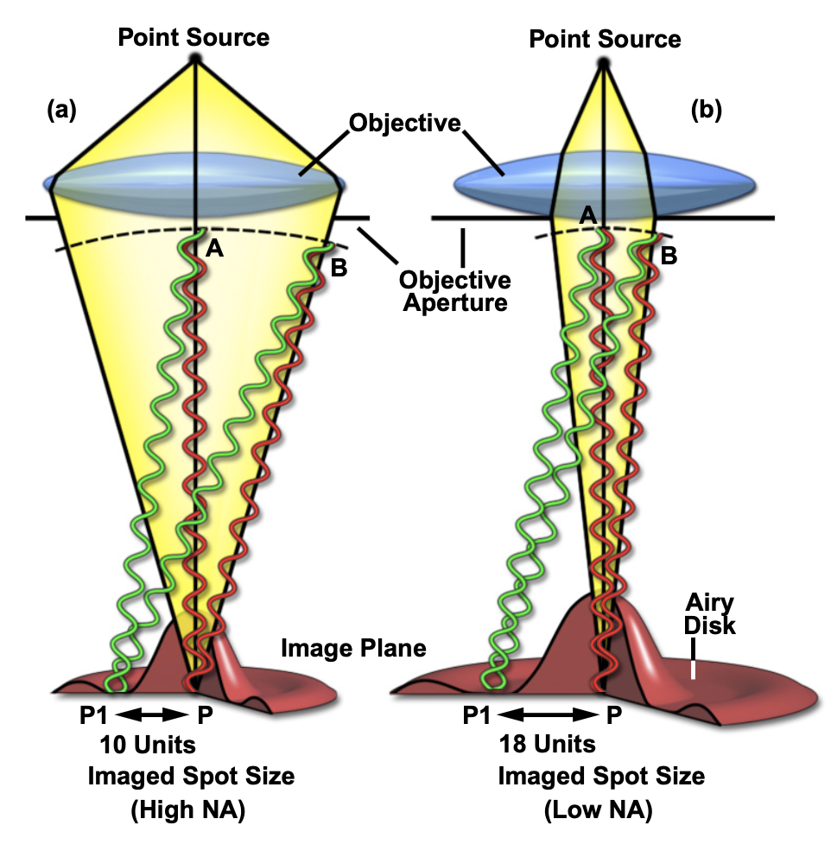
Wavelength nature of light reduces resolution
Point sources are transformed by the microscope into an image that does has a finite diameter.
The smaller the NA of the microscope is, the larger the spot is
The transformation of a point source into a finite spot is called the point spread function.

Slide 3
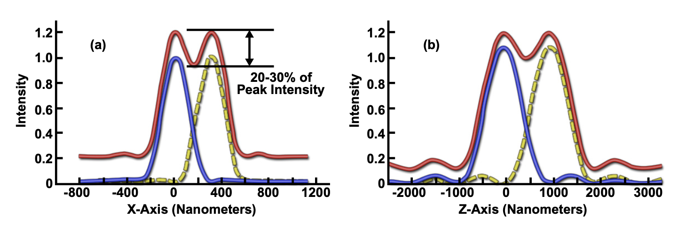

The point spread function has dimensions in X,Y, and Z
It determines how close point sources can be together to still be able to resolve them as two separate identities
The resolution can be approximated by:
$$Abbe Resolution_{XY}=λ/2NA$$
$$Abbe Resolution_{Z}=2λ/NA^{2}$$
For a perfectly sharp object viewed through a microscope it means that the resulting image is not infinitely sharp.

Slide 4
The microscope as a filter
The resolution limit can also be described in terms of signal processing.
Remember: any temporal signal (waveform) can be described as a sum of Fourier components in time.
Images can be similarly decomposed into spatial frequencies.

Slide 5
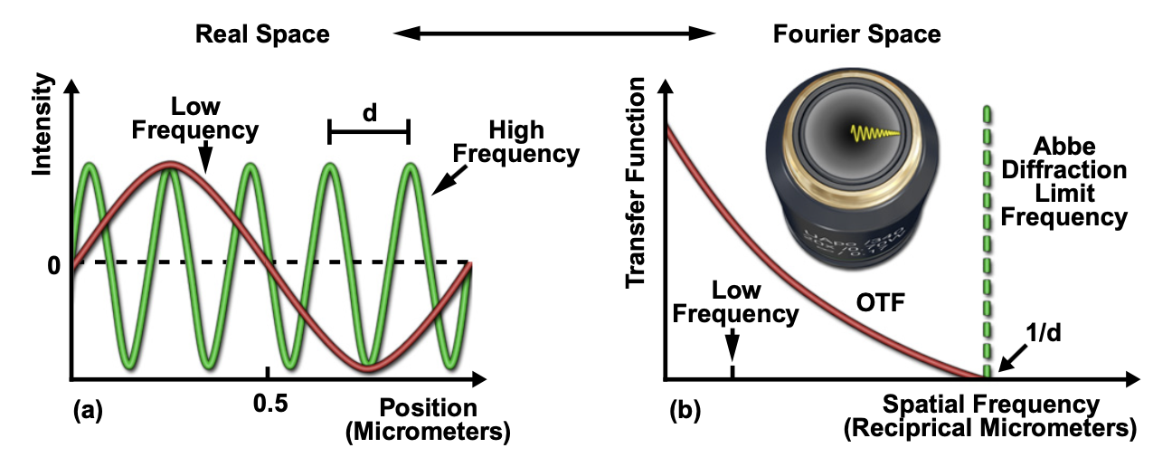
Just like any other measurement instrument, a microscope has am maximum bandwidth. This bandwidth is given by the abbe diffraction limit.
In 2D the bandwidth can be plotted in Fourier space as a circle. The larger the circle, the higher the achievable special resolution.

Slide 6
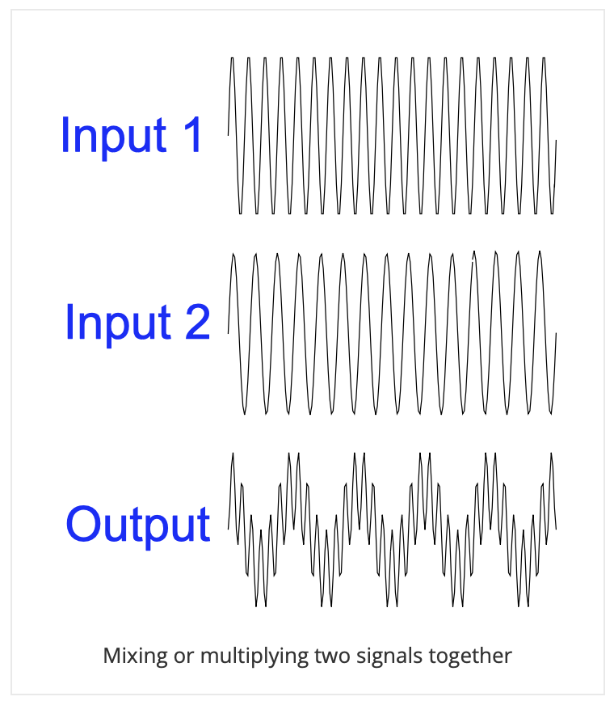
In signal processing, frequency modulation techniques have been developed to measure the amplitude of very high frequencies with low frequency electronics (for example in radios).
Signals of two slightly different frequencies are mixed.
Mixed signal = sin(ω1t)*sin(ω2t)
= ½ cos(ω1 – ω2)t – ½ cos(ω1 + ω2)t
(ω1 + ω2) is above the cut-off frequency of the electronics
Only cos(ω1 – ω2)t remains.
If you know the frequency and amplitude of the mixing frequency ω2, you can back-calculate the amplitude and frequency of ω1.
We can use a similar «trick» in microscopy

Slide 7

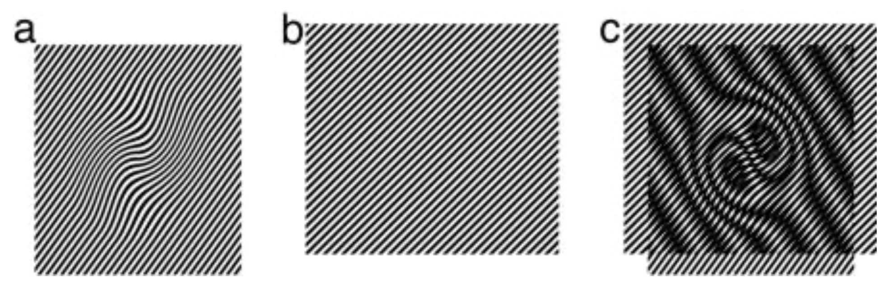

Structured illumination microscopy (SIM)
Frequency mixing is done by illuminating the sample not with a uniform illumination, but with a striped pattern of known frequency.
X
=
$$A_{ω}cos\left(ω_{sample}x\right)×\cos\left(ω_{ill}x\right)$$
$$=\frac{A_{ω}}{2}\cos\left(\left(ω_{sample}−ω_{ill}\right)x\right)+\frac{A_{ω}}{2}\cos\left(\left(ω_{sample}+ω_{ill}\right)x\right)$$

Slide 8
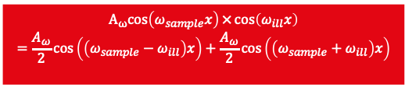
Microscope removes high frequencies
$$A_{ω}cos\left(ω_{sample}x\right)×\cos\left(ω_{ill}x\right)$$
$$=\frac{A_{ω}}{2}\cos\left(\left(ω_{sample}−ω_{ill}\right)x\right)+\frac{A_{ω}}{2}\cos\left(\left(ω_{sample}+ω_{ill}\right)x\right)$$

Slide 9
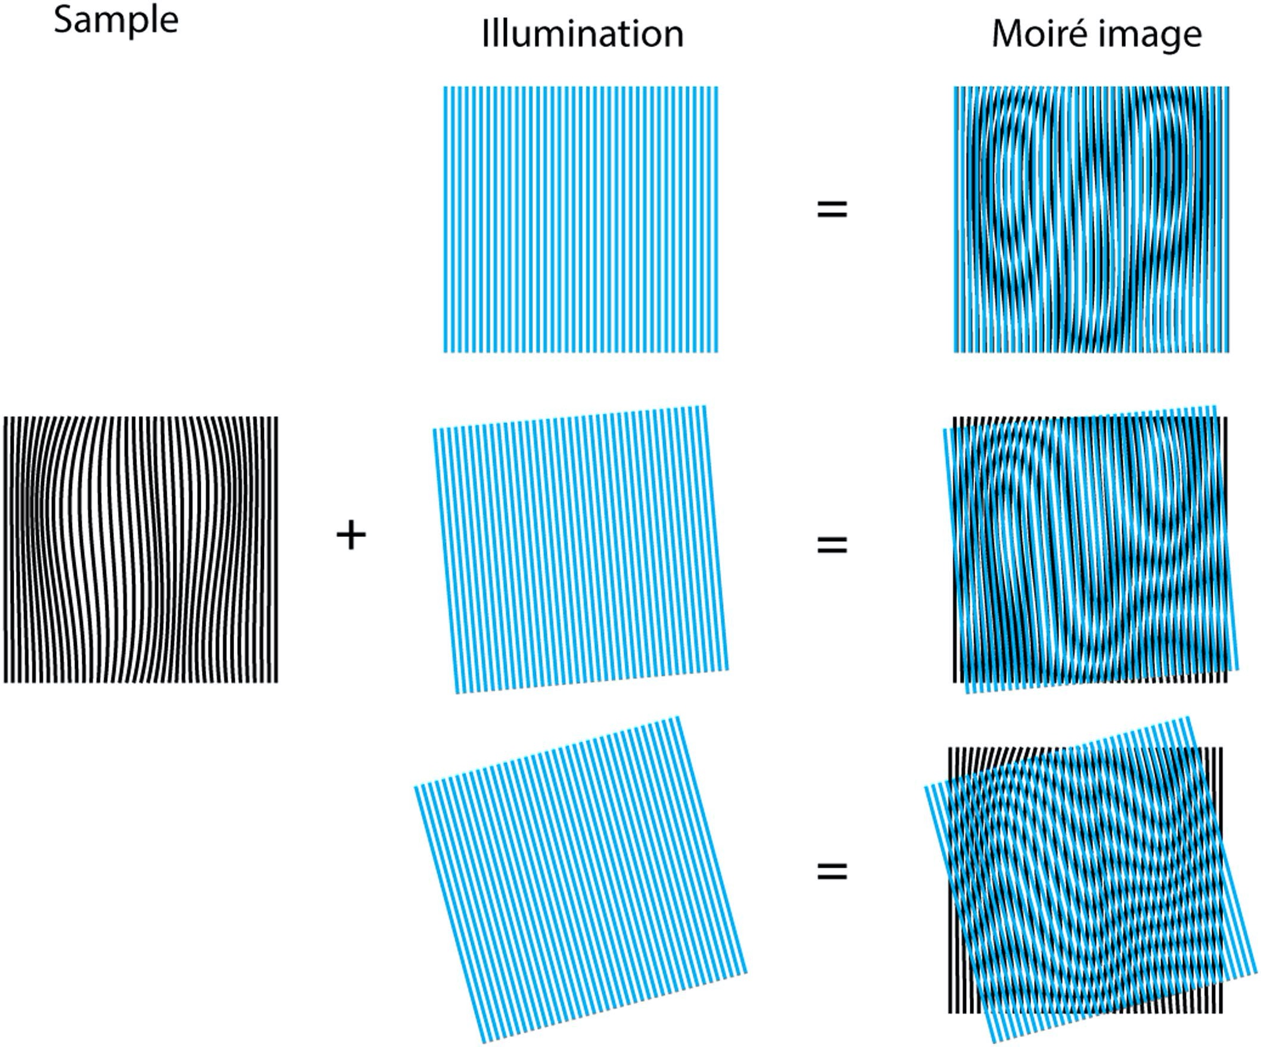
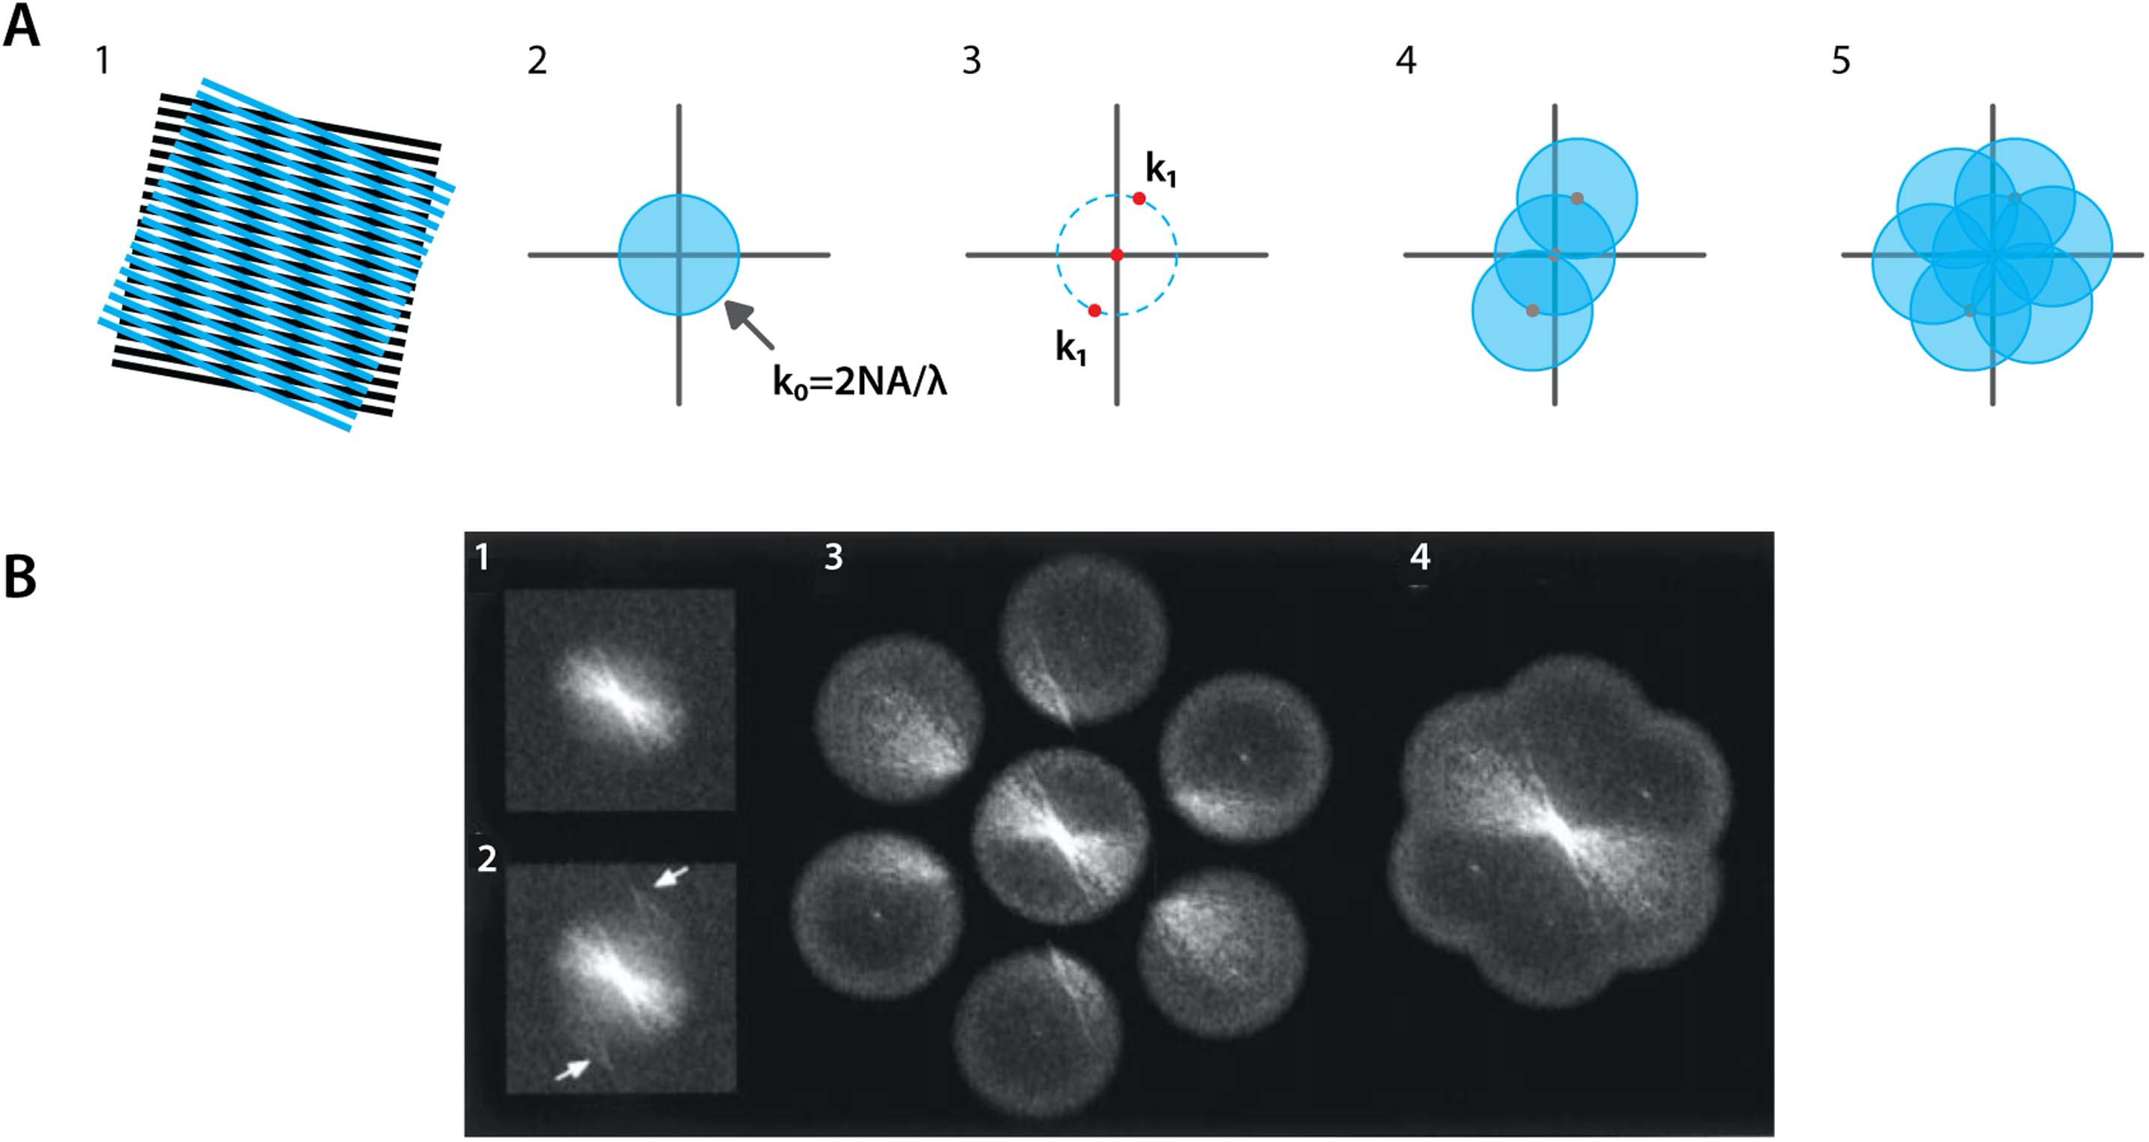
We can do the structured illumination with different displacements and rotations.
Each image with striped illumination expands the imaged Fourier space in a different direction. Reassembling the Fourier transforms of the individual images results in information with twice the frequency content.

Slide 10
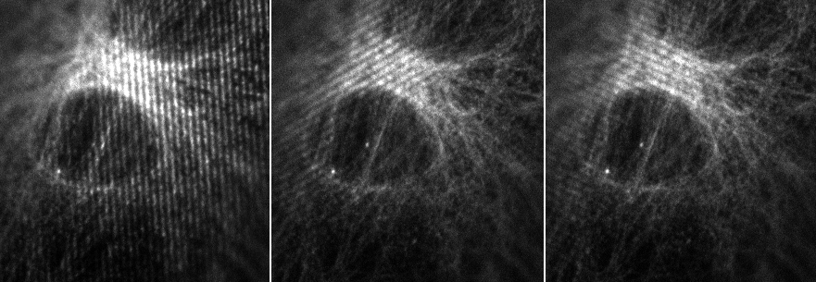
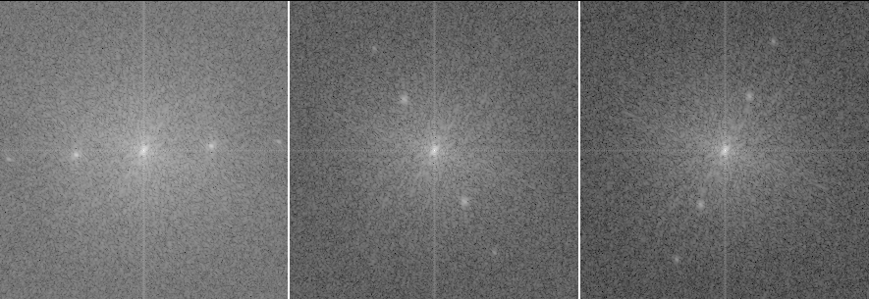
Projected pattern : zoom
Real space
FFT

Slide 11
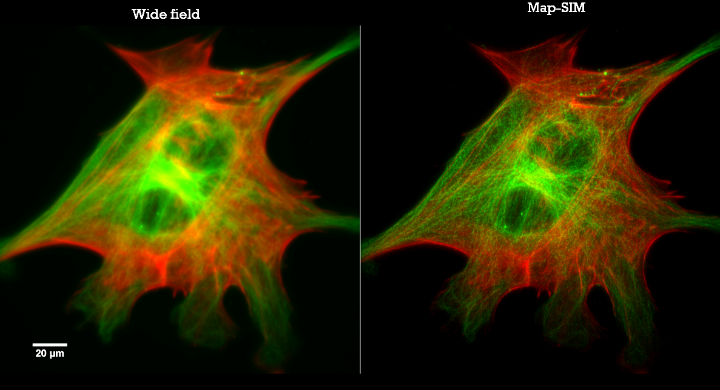

Slide 12
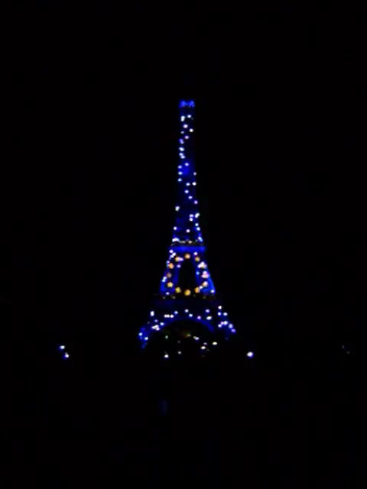
Single molecule localization microscopy
Basic principle: Separate spatially overlapping light sources in time

Slide 13
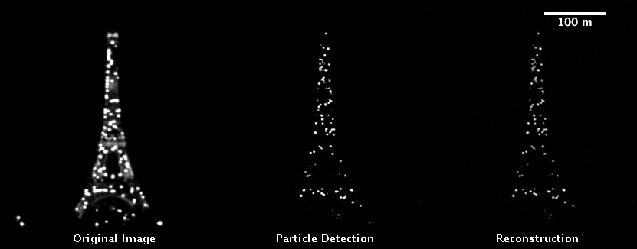
If you plot the centre of each light source as a dot, and sum them all up, you can reconstruct a super resolved image.

Slide 14
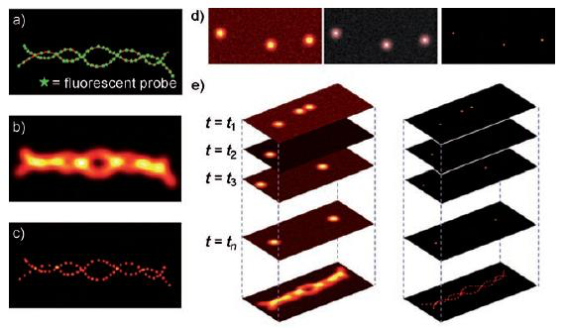
http://bme240.eng.uci.edu/students/08s/mkotlarc/images/PALM2.JPG

Slide 15
How to make fluorophores blink
Fluorophores can be made to occupy a non-emitting “dark” state. From this state, a small number of molecules are returned to the emitting state at any given time, where thy can be excited and emit photons that can be detected.
Stochastic Optical Reconstruction Microscopy (STORM) uses stochastic photosetting of organic dyes. For STORM one only needs one wavelength.
Photoactivation Localization Microscopy (PALM) uses photoactivatable fluorescent proteins (PS-FPs) such as photoactivatable GFP. The emission intensity can be tuned using light of particular wavelengths. These PA-FPs are initially in a dark state. Using a flash of light of appropriate wave length, a small subset of PA-FPs is moved into the dark state where it can be excited with an excitation wavelength after which it emits at the emission wavelength.

Slide 17
STimmulated Depletion Emmission microscopy (STED)
Confocal microscopy: In scanning confocal, only one pixel at a time is illuminated. The beam is raster scanned over the sample and the image is reconstructed digitally. The resolution is limited by the size of the illumination spot.
STED is a scanning confocal microscopy technique, where the size of the emitting area of the spot is reduced by depleting fluorescence in specific regions of the sample while leaving a centre focal spot active to emit fluorescence.
Remaining fluorescence area
Excitation spot
De-excitation spot

Slide 18
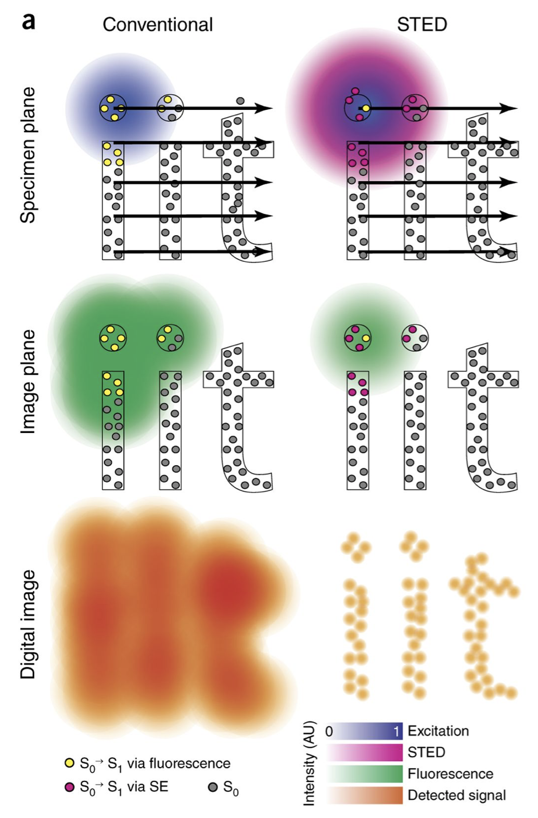
When scanning the STED beam, only the fluorophores inside the excitation spot are excited.
Those fluorophores that also are inside the STED doughnut are stimulated to emit. This emission occurs at a wavelength red-shifted from the normal fluorescence. These red shifted photons can be filtered out from the detected signal.
Only the fluorophores that fall inside the excitation beam, but NOT in the STED doughnut are used for image reconstruction.
Vicidomini et al. Nature Methods volume 15, pages173–182(2018)

Slide 20
Summary
Microscopes are imaging systems based on lenses, filters, apertures. Dichroic beam splitters and phase elements. Many different microscopy methods are possible depending how these elements are combined.
In traditional imaging systems, the maximum obtainable resolution is determined by the diffraction limit. It depends on the wavelength, the numerical aperture, and the medium that the object is imaged in.
Super resolution microscopy techniques are advanced microscopy techniques that overcome the diffraction barrier. The microscopes however do no longer create a “real image”. The image is reconstructed in a computer.

Slide 21
Useful resources
MicroscopyU: https://www.microscopyu.com
iBiologyEducation: https://www.youtube.com/user/iBioEducation/playlists?view=1&shelf_id=2&sort=dd
“An introduction to optical super-resolution microscopy for the adventurous biologist” J Vangindertael et al 2018 Methods Appl. Fluoresc. 6 022003, https://doi.org/10.1088/2050-6120/aaae0c

